Slide 1
INTRODUCTION TO COMPLEXITY FOR COMMUNITY DEVELOPMENT PRACTITIONERS
By Kirsten S. Moy
Past Visiting Scholar, Federal Reserve Bank of SF and
Senior Fellow, Aspen Institute
March 2019 Draft

Slide 2
Contents for Discussion
What is Complexity Science (CS)?
What is Community Development (CD)?
What benefits do Complexity Science frameworks, concepts, approaches and tools bring to the practice of Community Development?
What would working from a CS lens look like?
How and where do we begin?

Slide 3
What is Complexity Science?
For those of you who don’t think you know, you likely know more than you think you do about Complexity Science: e.g., have you heard of………
Six degrees of separation, power laws, network theory, ecosystems, emergence, interaction effects, tipping points, long tails, positive deviance, wisdom of crowds…….………?
Complexity Science is not a new science but a multi-disciplinary way to look at complex phenomena, systems and problems, borrowing and building on the full array of scientific disciplines (e.g., physics, mathematics ,computational science, chemistry, biology, ecology, anthropology, sociology, psychology, economics, etc.) While the “explicit” study of complexity and complex systems dates at least to the 1970s, the Santa Fe Institute – the first research institute dedicated to the study of complex systems -- was founded in 1984. One of the Institute’s earliest funders was the MacArthur Foundation.

Slide 4
A Few Examples of Complexity and Complex Systems in the Natural and Man-Made World
Ant colonies
The human brain
The stock market
Voting behavior
The World Wide Web
Neighborhoods and communities

Slide 5
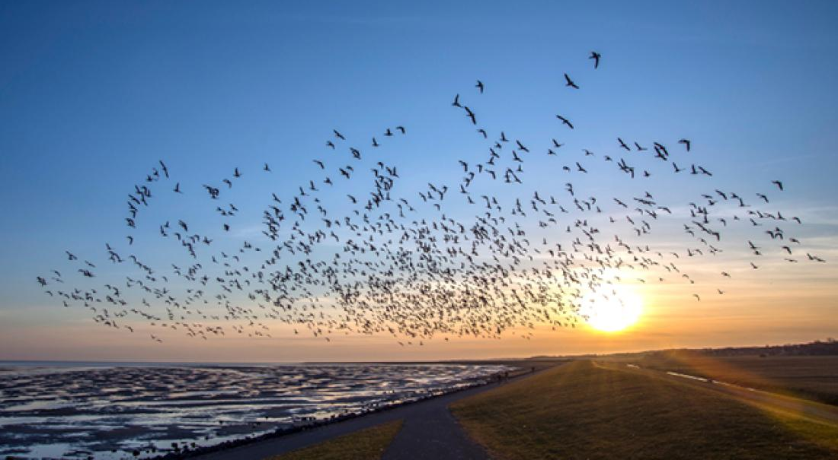
An Example of Complexity in Nature

Slide 6
What is a Complex System?
A Complex System (CS) is a system in which there are a large number of independent entities with no centralized control and where simple rules of behavior for the individual entities give rise to complex collective behavior.
A Complex Adaptive System (CAS) is a Complex System capable of learning, adaptation and evolution…………………..
Because of all the relationships and interactions between entities, there is no simple cause and effect in a CAS, and the reaction of the system to interventions and stimuli cannot be dependably predicted.

Slide 7
What is a Complex Problem?
A Complex Problem is one that cannot be fully specified and predictably solved with a set recipe or established protocol.

Slide 8
An Example of a Complex Problem in Every Day Life
Raising a child is a complex problem. Formulas have limited application and successfully raising one child provides experience but no assurance of success with the next.

Slide 9
The Difference between Complex Problems and Simple or Complicated Problems
Simple problems can be fully understood and predictably solved by following a set recipe or protocol.
Complicated problems: (e.g., like sending a rocket to the moon) involve a larger scale and have increased requirements around coordination and specialized expertise; but achieving one success can predictably lead to another successful outcome with a relatively high degree of certainty.

Slide 10
What is Community Development
The amelioration of poverty and its negative manifestations in underserved communities (Traditional)
According to some CDC leaders, “making their communities competitive for investment”
“The work of building and sustaining neighborhoods” (BECCD definition)
“A process where community members come together to take collective action and generate solutions to common problems” (United Nations definition)
…. “the emergent property of complex and dynamic social systems…a means of managing chaos, building resilience and devising innovative collective solutions to intractable problems” (from The Well-Connected Community by Alison Gilchrist, UK scholar and practitioner)
(Note: In the United States in the 1960s, the term “community development” was sometime used as a euphemism for “urban renewal”)

Slide 11
Why do we need Complexity Science in Community Development?
Communities are Complex Adaptive Systems (CAS); and
Most problems in the field that we know of as Community Development are Complex Problems
But that’s not generally how we think about and address problems in Community Development……..

Slide 12
How the Logic Model, a traditional framework for thinking about how we address social problems (such as Community Development), inhibits our thinking:
We identify a problem
to which we apply Inputs (by carrying out certain Activities),
which produce certain Outputs,
which produce certain Outcomes,
which hopefully produce the Impacts we desire
Assumptions: Linearity, separability, and predictability

Slide 13
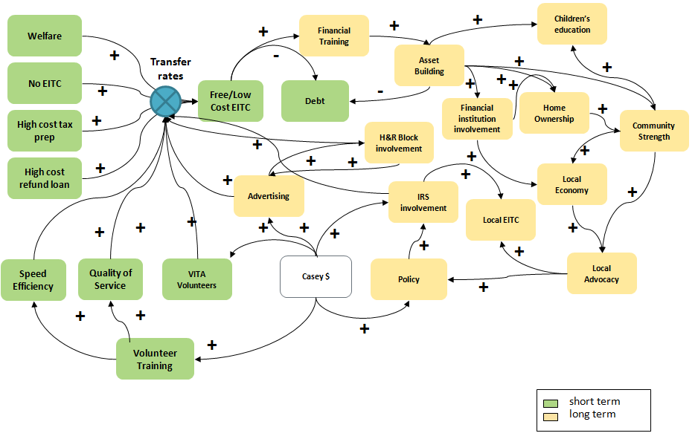
But the reality of the solution to the problem looks more like this………..

Slide 14
Learning from Five Case Studies on Dealing with Complexity in Community and Economic Development

Slide 15
Learning from Five Case Studies on Dealing with Complexity in Community and Economic Development
La Cocina: Working from an Ecosystem Perspective to Impact the Livelihoods of Small Entrepreneurs in San Francisco’s Food Industry
Purpose Built Communities: Transformation in the East Lake Community of Atlanta and Beyond
Cities for Financial Empowerment Fund: the Financial Empowerment Center Replication Initiative
Family Independence Initiative: Putting Families in the Driver’s Seat on the Road out of Poverty
Emergent Detroit: the Revitalization of Detroit’s Communities from the Ground Up
Notes:
The case studies were drawn from a larger group (50/500 sites) of multisectoral, collaborations around the country. Consciously strove for very different types of initiatives; realized later all were close to 20 years old. And they differ in degree of self-organization vs. centralized control or direction: e.g., (from lowest to highest): Emergent Detroit, FII, La Cocina, PBC, Cities for Financial Empowerment. NOT SAYING THEY ALL DEMONSTRATE ALL ASPECTS OF WORKING FROM COMPLEXITY AND CS.

Slide 16
Example 1 – La Cocina: an Ecosystem Approach to Change (San Francisco, CA)
La Cocina is both a space with a commercial kitchen in SF’s Mission District and a business incubator that supports food-related businesses primarily run primarily by women of color and immigrants
Services and supports provided: affordable commercial kitchen space, industry-specific TA, greater exposure and connections to markets
Theory of Change: “…..without changes in perception, greater inclusivity and changes in the structure of the food services industry, low-income and immigrant entrepreneurs will always face greater barriers to entry and success……….”
La Cocina’s work helps to create a virtuous cycle where the entry of new and innovative food offerings and voices contributes to the greater robustness and vibrancy of the San Francisco food industry, a key economic sector of the Bay area. (SF Chronicle, May 2015)

Slide 17
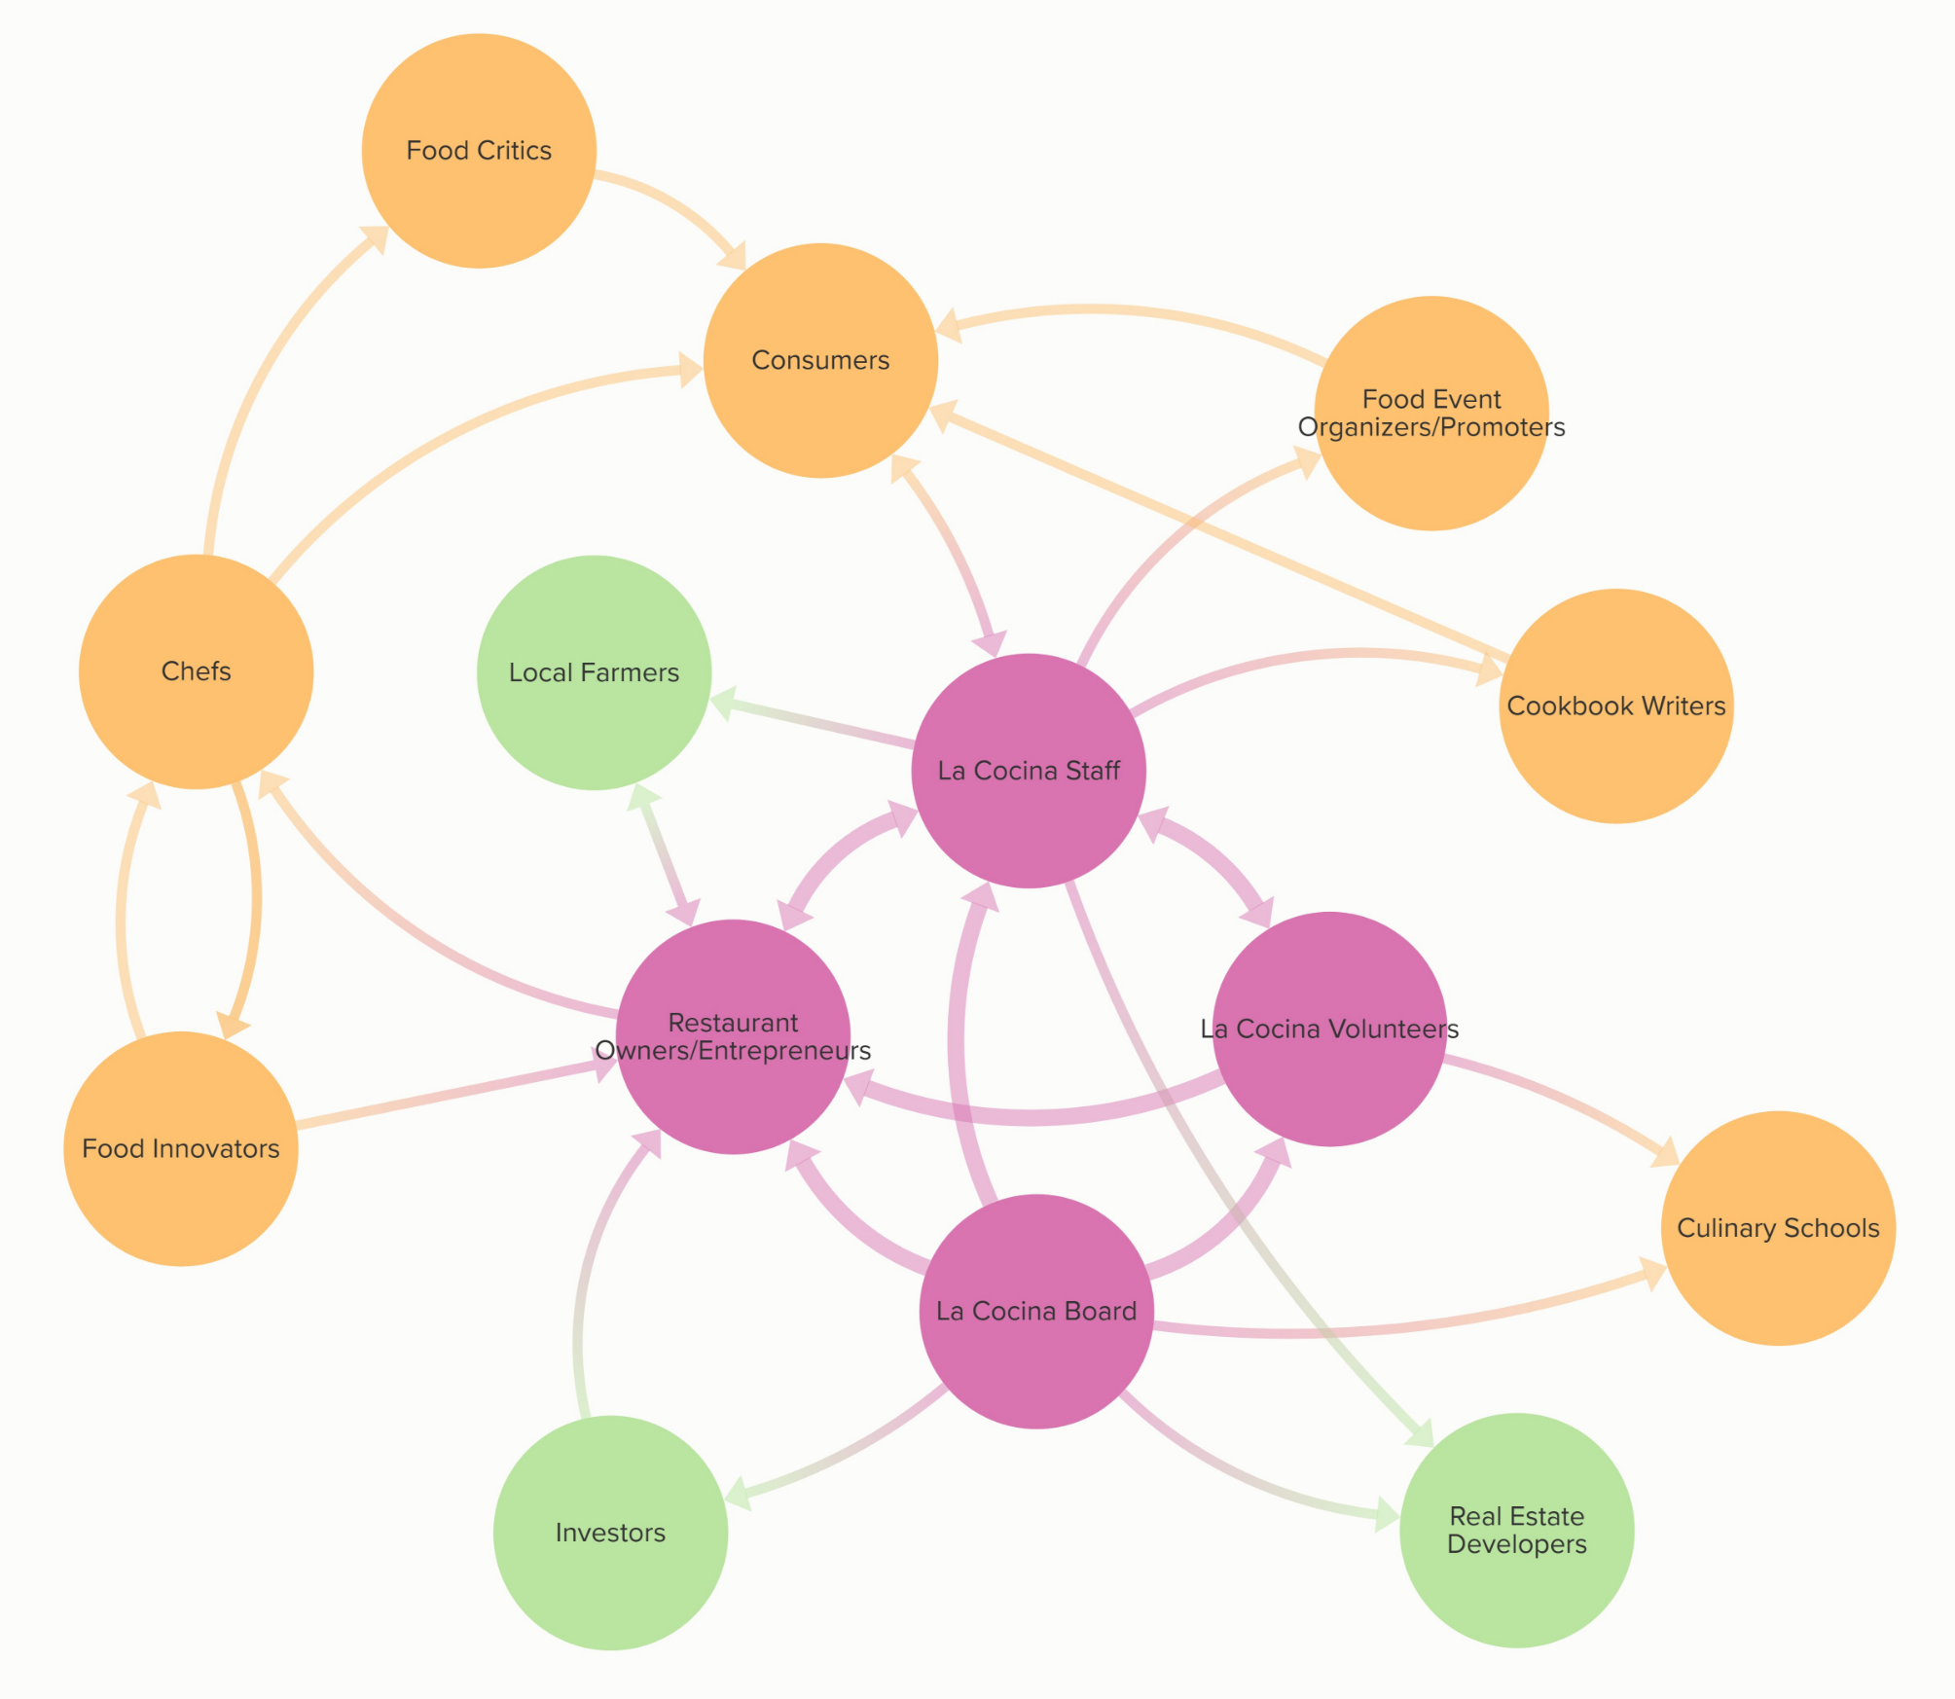
La Cocina’s Ecosystem in the Bay Area
The Ecosystem -
Chefs, food critics, food innovators, food event organizers,
culinary schools,
restaurant owners, real
estate developers, investors, local
farmers, consumers, La Cocina graduates, staff, board & volunteers………….

Slide 18
La Cocina by the Numbers
At any time, La Cocina’s incubator is home to between 30 and 40 up-and-coming businesses. In 2017, 91% of the businesses were women-owned, over 80% by people of color, and 67% immigrants
As of the end of 2017, close to 100 businesses have been through La Cocina and there are now 26 brick and mortar restaurants
Sales for La Cocina businesses in 2017 totaled approximately $13 million, with 95 jobs created, and total wages paid by these businesses approaching $600,000
During the same period, La Cocina brokered over $552,500 worth of catering opportunities for 33 businesses and provided 43 entrepreneurs with almost 1,900 hours of technical assistance, valued at close to $183,700

Slide 19
Example 2-Purpose Built Communities (PBC): the Revitalization of the East Lake Neighborhood in Atlanta
East Lake declined from being one of Atlanta’s most glamorous neighborhoods in the ‘50s to being one of the city’s most devastated in the ‘80s and ’90s with crime-ridden public housing and a HS graduation rate of 30%.
Revitalization of East Lake imagined and led by Tom Cousins, an Atlanta developer and philanthropist, with funding primarily from the private sector.
Based on research about concentrated poverty and early application of complexity science to “Comprehensive Community Initiatives (CCIs),” Cousins and his team developed the PBC model and theory of change.

Slide 20
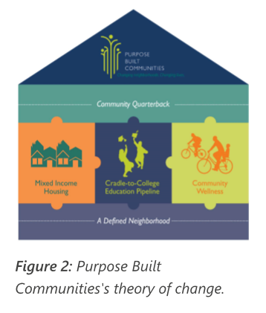
The Purpose Built Communities (PBC) Model and Theory of Change
Complexity concepts at work: treating communities as CAS, recog-nizing feed-back loops, interaction effects, & tipping points, allowing for learning/adaption/emergence, creation of virtuous cycles, goal of ecosystem change
Components of the
PBC Model & T of C:
Defined Neighborhood.
Mixed-Income Housing,
Cradle-to-College
Educational Pipeline,
Community Wellness,
Presence of a
“Community QB”

Slide 21
East Lake – Transformation by the Numbers
A few metrics demonstrate the dramatic changes that have occurred in the East Lake neighborhood:
Total crime has been reduced over a 20-year period by 76% and violent crime by 97%;
The elementary school has gone from being the lowest-performing school in the Atlanta Public School System to being consistently ranked among the top ten schools in the system while still serving predominantly low-income students;
In the Villages of East Lake median household incomes have increased significantly; in 1995, the average annual income in East Lake was $4,500, while the median household income for a working family receiving a housing subsidy today is over $23,000;
In line with the goal of preserving East Lake as a mixed-income neighborhood, household incomes in The Villages today range from less than $10,000 to more than $100,000 a year.
(PBC currently has 18 active sites in 17 cities, with more in the pipeline)

Slide 22
Example 3 –Cities for Financial Empowerment Fund/National Financial Empowerment Center (FEC) Initiative
Theory of Change: embedding one-on-one financial counseling/education into city services and programs will increase the efficacy of municipal programs by improving the financial stability of low- and moderate-income households.
Program first pioneered in the Bloomberg administration in New York City with creation of FECs in a number of NYC neighborhoods ; piloted in Denver, Lansing, Nashville, Philadelphia and San Antonio; now launching in 12 additional cities.
Application of complexity principles: interaction effects (“Supervitamin Effect”), ecosystem change, creation of virtuous cycles – for cities and their clients.

Slide 23
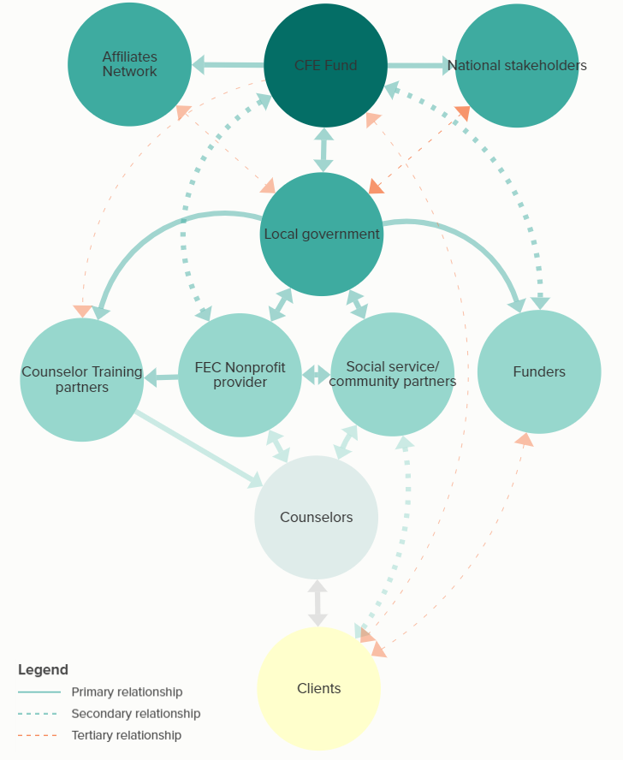
Ecosystem for the Financial Empowerment Center Initiative
The Ecosystem -
CFE Fund, national funders, Affiliates Network, local govt. agencies, local nonprofits incl. social service providers & training orgs, local funders, counselors and clients.

Slide 24
Examples of Integration in Different City Programs
First-time Homebuyers Program
Financial Counseling for City Employees
Workforce Development
Small Business Incubator
Parolee Housing
Utility Services
Libraries
Legal Services

Slide 25
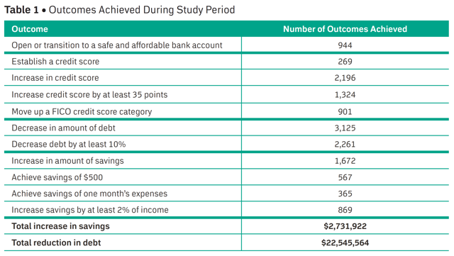
CFE Financial Empowerment Initiative by the Numbers in a 3-Year Pilot in 5 Cities: Denver, Lansing, Nashville, Philadelphia and San Antonio

Slide 26
The Family Independence Initiative: Putting Families in the Driver’s Seat on the Road Out of Poverty
Principles of FII: any initiative must focus on people’s strengths, not their deficits; it takes a group – not a program – to move a person or family out of poverty; history and traditions give us many of the solutions we need; top-down solutions have never been true instruments of change; self-defined plans can grow organically and scale quickly; mutuality and community are the vital ingredients.
Notes:
Background story: Maurice Lim Miller (MacArthur genius) and Jerry Brown. Mother was an immigrant and single mom. How did she lift her family out of poverty, at least to extent of sending a son to Berkeley to study engineering?

Slide 27
The Family Independence Initiative: Putting Families in the Driver’s Seat on the Road Out of Poverty
How the “Unprogram” works: families wishing to participate in FII are asked to organize friends/colleagues/community members into a group of 5 for more families work with; groups cannot be primarily immediate family members.
Families complete a nomination form with basic family information and aspirations and goals.
Families gather for two pre-enrollment meetings at which all groups members must be present

Slide 28
The Family Independence Initiative: Putting Families in the Driver’s Seat on the Road Out of Poverty
If group members decide to move ahead, they complete a profile, create first journal entries with staff, and begin monthly group meetings, journal entries and audits with staff
Families commit to submit online monthly journal entries, facilitate cohort meetings, and meet for quarterly audits with staff
Participating families are able to access a pool of funds and other opportunities through the Resource Hub; examples of resources are laptop and software to complete the online journals, compensation for time invested and data provided, matched savings, funds to enable families to provide recreational and educational experiences for their children, scholarships and fellowships, etc.
FII staff are called “liaisons;”they are not social workers or program officers; their role is to listen and ask questions, not to give advice or even suggest actions. (Staff who have done so have been fired.)

Slide 29
Complexity concepts and approaches at work in FII
Working from an ecosystem perspective; helping families develop both “Strong” and “Weak” Ties
Encouraging Self-organization and Emergence
Creating Feedback Loops through data capture and sharing to promote learning and motivate behavior change
Recognizing Positive Deviance and Encouraging Positive Deviants to model behavior and lead change

Slide 30
FII by the Numbers
Over 17 years, FII has expanded to include the following sites: Northern California, Boston & Cambridge, New Orleans, Detroit, Albuquerque and Cincinnati
Since 2001, FII has enrolled close to 2000 families with a total of close to 7000 family members
During the two years of engagement with FII, the typical family reports:
a 23% increase in monthly income and a 60% decrease in subsidies such as TANF an SNAP;
an increase in their monthly savings account balance from less than $100 to over $1,000
An 89% increase in monthly business income plus 67% increase of family-owned business activity, for those with business activities or enterprises

Slide 31
Emergent Detroit: the Revitalization of Detroit’s Neighborhoods from the Ground Up
Brief history of the rise and decline of the Motor City, including its much reported bankruptcy in July of 2013 and beyond
A quick view of the attempted revitalization of the City through top-down redevelopment initiatives especially of the Urban Core: building of the casinos, move of the headquarters of Quicken Loans to downtown Detroit, redevelopment of the city’s riverfront, revival of the Midtown corridor, building of the light rail from Downtown to the edge of Midtown, etc.
Notes:
FII has a Detroit site; and CFE is adding Detroit as one of its sites in its FEC Replication Initiative
Additional Detroit resources: 2 TED talks (Drew Philp and Devita Davidson

Slide 32
Emergent Detroit: the Revitalization of Detroit’s Neighborhoods from the Ground Up
The Alternative (or at least a necessary complement) is the revitalization of the City through the redevelopment of Detroit’s neighborhoods from the ground up, e.g., through:
Placemaking Initiatives: a “collaborative process by which …(residents) can shape (their) public realm……With community-based participation at its center, an effective Placemaking process capitalizes on a local community’s assets, inspiration, and potential…“it is a strategy for building community capacity through place.”
Urban Agriculture, the development of a local economic sector
Filling of Critical Gaps in Community Infrastructure: Community-owned Internet
The BECDD (Building the Engine of Community Development in Detroit) Initiative: a “citywide collaborative process to strengthen all of Detroit’s neighborhoods by creating a well-coordinated, effective and equitable framework for community development in the city

Slide 33
Emergent Detroit: Examples of What Complexity Has Wrought in Detroit Neighborhoods
Placemaking: ioby (since 2014) – 71 projects, with $192,600 raised from over 2,200 donors, mostly individuals living within a 5-mile radius
Detroit Soup (as of 2010) – over 151 SOUP dinners with over 15,000 in attendance and $132,000 raised for projects in the arts, education, social justice, housing, small businesses, etc.
Public Spaces Community Places: the State of Michigan’s placemaking initiative has provided matched funding of up to $50,000 for projects in a number of Detroit neighborhoods, but the first funds must be crowdfunded.

Slide 34
Emergent Detroit: Examples of What Complexity Has Wrought in Detroit Neighborhoods
Urban Agriculture – a legacy of the Great Migration: in 2017, there were 865 families growing in backyards, 440 community groups reclaiming vacant spaces, 136 school gardens, 106 market-focused gardens bringing fresh local food to Detroiters, engaging over 23,000 individuals growing food for themselves, their families and their community, in one of the largest urban food deserts in the U.S.

Slide 35
Emergent Detroit: Examples of What Complexity Has Wrought in Detroit Neighborhoods
Filling Critical Gaps in Community Infrastructure:
A May 22, 2016 New York Times article identified Detroit as the city with the worst rate of internet access of any large American city, with 4 out of 10 of Detroit residents lacking broadband
City officials and economists among others identified the lack of internet access as a crucial if underappreciated factor in the dismal employment rates plaguing many of the city’s neighborhoods.

Slide 36
Emergent Detroit: Examples of What Complexity Has Wrought in Detroit Neighborhoods
In 2012 Detroit-based Allied Media, a leader in media-based organizing, partnered with the Open Technology Institute of the New America Foundation to create the Digital Stewards Program to train neighhorhood leaders in designing and deploying community wireless networks with a commitment to “access, participation, common ownership and healthy communities”

Slide 37
Emergent Detroit: Examples of What Complexity Has Wrought in Detroit Neighborhoods
BECDD: as of early 2018, more than 140 of Detroit CBOs and institutions have participated in the multi-phase BECDD effort launched in 2015, reaching consensus on definitions for community development and Community Development Organizations (CDOs) in Detroit, what constitute the critical elements for a Community Development System in Detroit; and the forging of a unified voice for community development in the city.

Slide 38
Emergent Detroit: Demonstrations of Complexity at Work in Detroit Neighborhoods:
Self-organization
Emergence
Development and strengthening of Strong and Weak Ties
Feedback Loops and Interaction Effects
Development of many aspects of local Ecosystems, including organizations, networks, processes and infrastructure
Positive Deviance
Wisdom of Crowds

Slide 39
Learning from these examples: What applying the frameworks, concepts and approaches of Complexity Science to Community Development would mean:
Working from an ecosystem perspective, paying attention to history and culture and identifying and strengthening/building key networks, relationships, processes and infrastructure
Understanding the system dynamics of the ecosystem in question (e.g., tipping points, feedback loops, interaction effects, drivers)
Focusing on root causes vs. symptoms (i.e., upstream vs. downstream)
Committing to and operationalizing community engagement – working from the ground up

Slide 40
Learning from these examples: What applying the frameworks, concepts and approaches of Complexity Science to Community Development would mean:
Replacing negative cycles of decline and disinvestment with virtuous cycles, building not on the needs and deficiencies of a community but on its assets
Understanding and intervening at the different levels at which an issue or problem occurs (e.g., the neighborhood, city, region, state and national levels) with appropriate strategies and actions at each level
Allowing for learning, adaptation and emergence
Looking for and learning from “unintended consequences”
Seeking out the positive deviants in the community and letting them inspire and lead.

Slide 41
Final Thoughts
Social capital and cohesion are a necessary (but insufficient) condition for community development; no further development of any kind is possible without it.
Building equity and inclusion is only possible working from an ecosystem framework and perspective
Community transformation is not a matter of simply “moving the needle” (no matter of how many indicators) of community distress, but shifting an ecosystem (or in some cases creating one) from one that produces dysfunction to one that produces a healthy, vibrant community with and for its residents

Slide 42
A New Definition of Community Development from a Complexity Science Perspective
Community development is not something done to, or even done for, a group of people; it is something that emerges when there is social capital and cohesion and when the freedom, relationships, means and resources needed for development or transformation exist within an enabling ecosystem.

Slide 43
In the end, we must remember that:
Virtually all the outcomes we seek to achieve in communities are emergent phenomena and cannot be designed and engineered top-down; we can only create the conditions from the ground up for the outcomes to emerge.

Slide 44
Contact Information
kmoyaspensf@gmail.com
http://www.frbsf.org/community-development/

