Slide 1
sustainability
Ann Kinzig
kinzig@asu.edu

Slide 2
what are ecosystem services?
what is natural capital, and how does it relate to ecosystem services?
what is the role of biodiversity in delivering ecosystem services?
what is the role of scholarship or science in the sustainability discourse?

Slide 3
what are ecosystem services?

Slide 4
Focus: Ecosystem Services The benefits people obtain from ecosystems
Supporting
Nutrient cycling
Soil Formation
Primary Production
…
Provisioning
Food
Freshwater
Wood and Fiber
Fuel
…
Regulating
Climate Regulation
Flood Regulation
Disease Regulation
…
Cultural
Aesthetic
Spiritual
Recreational
…
Source: Millennium Ecosystem Assessment

Slide 5
The Problem(s)
Traditional conservation strategies privilege species and habitats over other types of services.
Many land use decisions ignore ecosystem services because there are no “signals” directing owners or managers to do otherwise.

Slide 6
Focus: Ecosystem Services The benefits people obtain from ecosystems
Supporting
Nutrient cycling
Soil Formation
Primary Production
…
Provisioning
Food
Freshwater
Wood and Fiber
Fuel
…
Markets for many provisioning services (efficient), but often with significant and unaccounted for externalities (leads to oversupply)
Regulating
Climate Regulation
Flood Regulation
Disease Regulation
…
Regulating services largely unaccounted for in existing markets or institutions (leads to undersupply)
Cultural
Aesthetic
Spiritual
Recreational
…
Some cultural services accounted for in decision making (e.g., recreation) while others are not

Slide 7
Some Solutions (not mutually exclusive)
Create mechanisms so that prices (values) are placed on currently unpriced or underpriced services
Internalize externalities
Create markets (payments for ecosystem services)
Impose regulations

Slide 8
Some Challenges
Ecosystem services can be difficult to manage optimally because there are potential trade-offs among ecosystem services, and there are issues of scale (the value of a service depends on the temporal or spatial scale under consideration).

Slide 9
The Challenge of Trade-Offs
Consider the case of the Phoenix metropolitan area
Some critical ecosystem services include freshwater provisioning, air quality regulation, local climate regulation (urban heat island), control of invasive species

Slide 10
The Challenge of Trade-Offs
F₁(Veg, Hydro, Soils, Landscapes, …)
Freshwater Provisioning
F₂(Veg, Hydro, Soils, Landscapes, …)
Air Quality Regulation
F₃(Veg, Hydro, Soils, Landscapes, …)
(Local) Climate Regulation
F₄(Veg, Hydro, Soils, Landscapes, …)
Control of invasive species
Complementarities and trade-offs
This hasn’t yet been effectively done for relatively complete sets of ecosystem services in different ecosystem types

Slide 11
what is natural capital, and how does it relate to ecosystem services?
a stock that yields a flow of goods and services
species? individuals? food webs?

Slide 12
The Challenge of Trade-Offs
F₁(Veg, Hydro, Soils, Landscapes, …)
Freshwater Provisioning
F₂(Veg, Hydro, Soils, Landscapes, …)
Air Quality Regulation
F₃(Veg, Hydro, Soils, Landscapes, …)
(Local) Climate Regulation
F₄(Veg, Hydro, Soils, Landscapes, …)
Control of invasive species
This hasn’t yet been effectively done for relatively complete sets of ecosystem services in different ecosystem types
Ultimately, these entries should be the capital stocks that underlie the flow of services

Slide 13
what is the role of biodiversity in delivering ecosystem services?

Slide 14
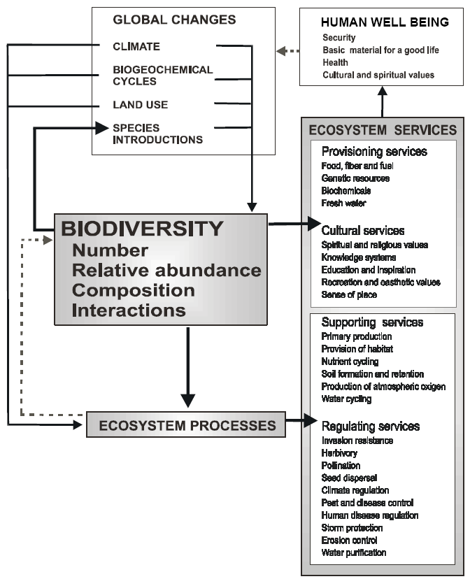
biodiversity
Implication: Increasing Biodiversity will positively influence ecosystem services.
If this were true, there would be no trade-offs among ecosystem services

Slide 15
biodiversity & ecosystem functioning
1
2
16
2
2
1
1
8
4
1
4
1
2
1
2
16
Ecosystem Functioning (NPP, stability, nutrients)
2
8
2
4
1
4
1
4
1
1
8
2
4
2
8
2
Species Richness

Slide 16
biodiversity & ecosystem functioning
sampling
monocultures
“superior” performer
“inferior” performer
tricultures
bicultures

Slide 17
biodiversity & ecosystem functioning
niche partitioning
monocultures
“superior” performer
“inferior” performer
tricultures
bicultures

Slide 18
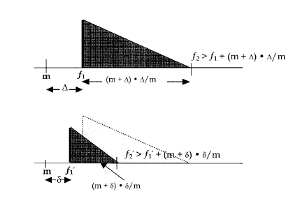
diversity within a community
In the special case of two species, this becomes
f₂ > f₁ + (m + Δ) Δ ÷ m
Where Δ = f₁ - m
But not here
Or invade here
Species can invade here
Height of the bar shows measure of abundance of i^{th} species
Kinzig, A.P., S.A. Levin, J. Dushoff, and S. Pacala. 1999. The American Naturalist 153(4):371-383.

Slide 19
diversity within a community
“Niche partitioning” [limiting similarity] is a fundamental concept in ecology.
Species “evolve away” from competitors [reduce interspecific competition]
If your competitor is light-loving (canopy seeking) become shade tolerant.
If your competitor is a slow-growing competitive dominant, become a colonizer.
Ecological (bioeconomic) models purporting to represent realistic species assemblages should model the “niche trade-off” structuring the system.
Species are not evenly distributed in trait space.

Slide 20
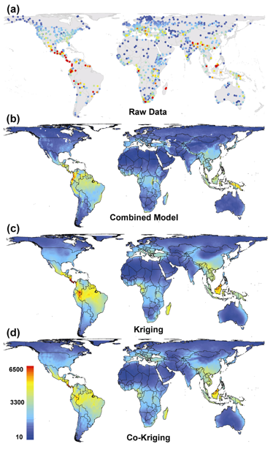
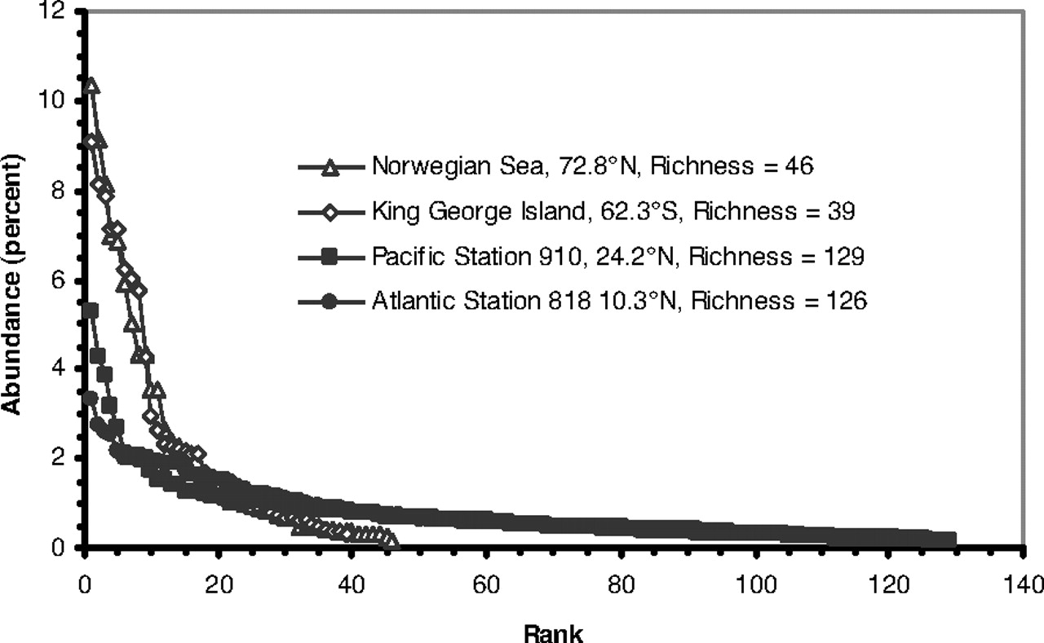
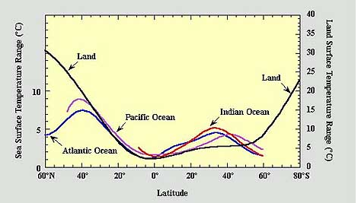
The competitive dominant tends to be less abundant in low latitudes
High latitude
Low latitude
Corresponding to increasing diversity at lower latitudes
Potentially driven by more equitable conditions [lower stochasticity in f and m?]
Fuhrman J A et al. PNAS 2008;105:7774-7778
H. Kreft and W. Jetz. PNAS April 3, 2007 vol. 104 no. 14 5925-5930

Slide 21
some problems with using diversity-functioning
Nature does not randomly assemble species
The competitive dominant may not be the one best suited for delivering the service of interest (think of the whole of agriculture)
If we know which species (configurations, entities) are best at delivering a particular service, why rely on sampling?

Slide 22
Some Challenges: Trade-offs
Supporting
Nutrient cycling
Soil Formation
Primary Production
…
Provisioning
Food
Freshwater
Wood and Fiber
Fuel
…
To Grossly Oversimplify…
Provisioning services are often enhanced through simplification of natural systems (reductions in biodiversity).
Regulating services are often positively correlated with biodiversity.
Cultural services have no “regular” relationship with biodiversity.
Regulating
Climate Regulation
Flood Regulation
Disease Regulation
…
Cultural
Aesthetic
Spiritual
Recreational
…

Slide 23
what is the role of scholarship or science in the sustainability discourse?
if people don’t hold a certain value, should we as scientists argue they should?
if we are asked to speak as scientists, should we confine ourselves to the science in our remarks?

