Slide 1
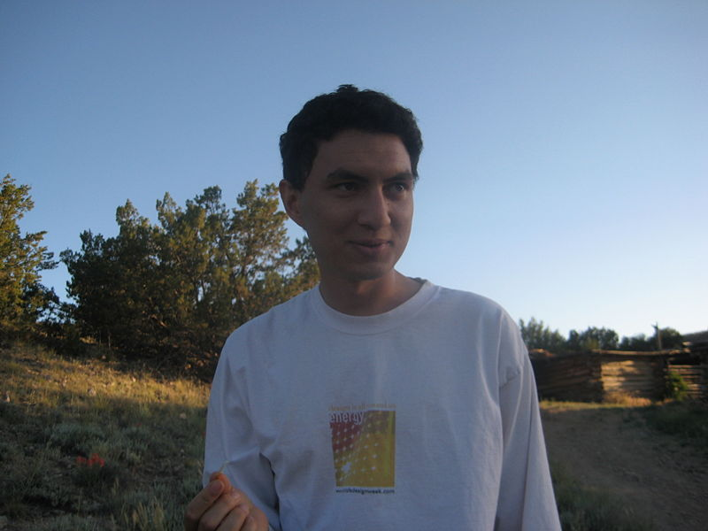
A four-scale complex resource management problem:
The case of the New Mexico Acequias
Gonzales, J. P.,
Henscheid, Zoe,
Johnson, Anne,
Lewis, Kim,
Ligtvoet, Andreas,
Putten, van Ingrid,
Shenoy, Raj,
Wise, Sarah.
Our fearless leader, 10th generation New Mexico resident, and acequia owner ….. J.P.

Slide 2
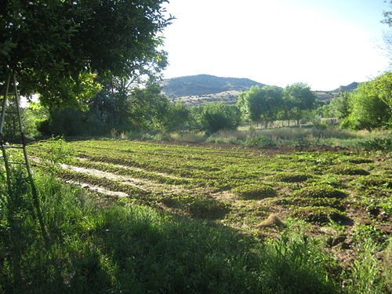
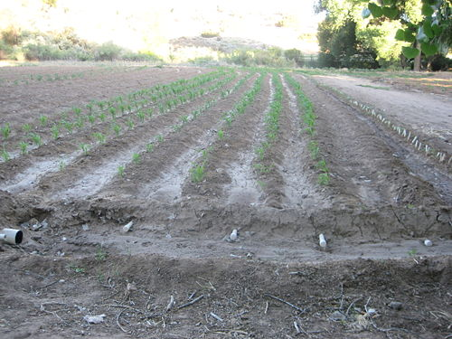
History
Acequia comes from classical Arabic "as-sāqiya",
which means "the water conduit".
The Arabs brought the technology to Spain
who then used it in the land they occupied around the place (like New Mexico)
Management
J P’s acequia irrigated garden
Cultural practices, referred to as the “repartimiento”, guide the allocation of water within and between acequias.
Each acequia has a democratically elected “Mayordomo”, who is responsible for distributing water
Acequia Irrigated Farmlands

Slide 3
Structure of acequias in New Mexico
Most acequias have a small number of irrigators
Within acequia, the size of most irrigated plots is small

Slide 4
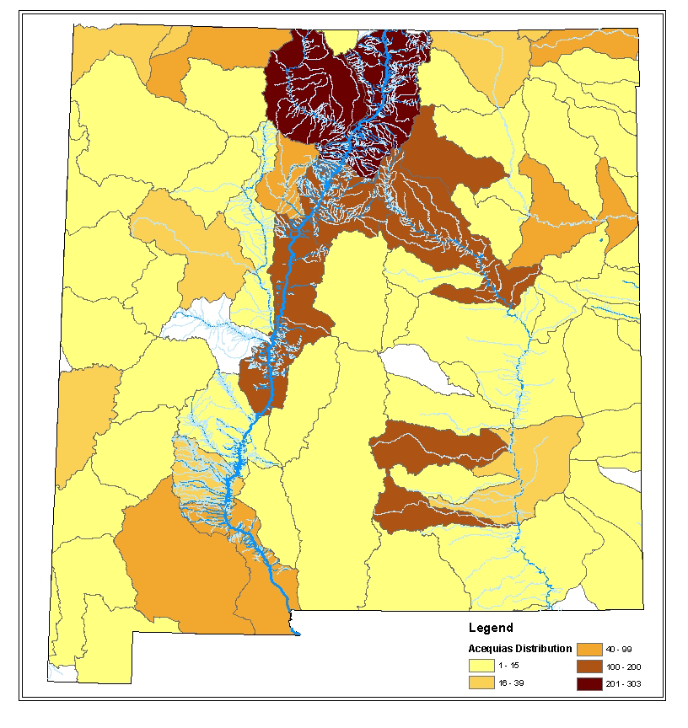
Geographic distribution of acequias in NM
Irrigated area
Number of irrigators
Area irrigated
Number of irrigators
13,746
Drainage basin
Canadian River – high use area
Pecos river – low use area
(i.e. high number of irrigators – low irrigated area)
Rio Grande basin by far the largest

Slide 5
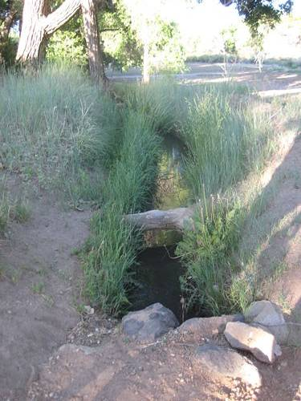
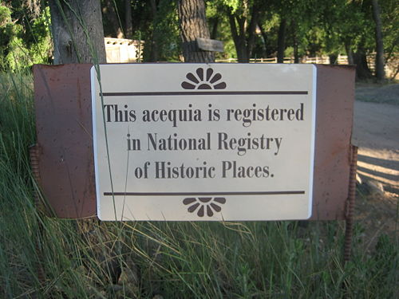
Question asked ….
What’s the problem (J P’s problem really …)
Changing nature of acequias due to (seemingly) external pressures
Disintegration of cultural & social significance of long established “institutions”
What information we had to start with
Some (local) studies confirming that pressures exist on acequias (e.g. subdivision)
Some anecdotal evidence - that the ‘nature’ of acequias is changing
No state wide studies exist (although some have been proposed)

Slide 6
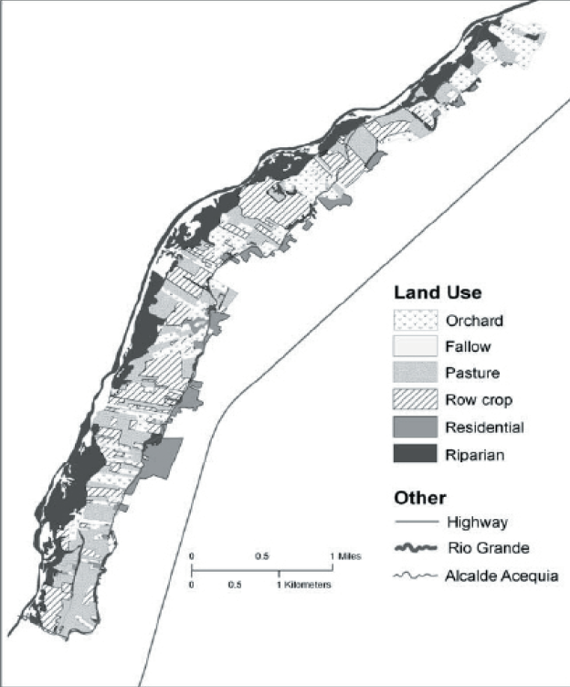
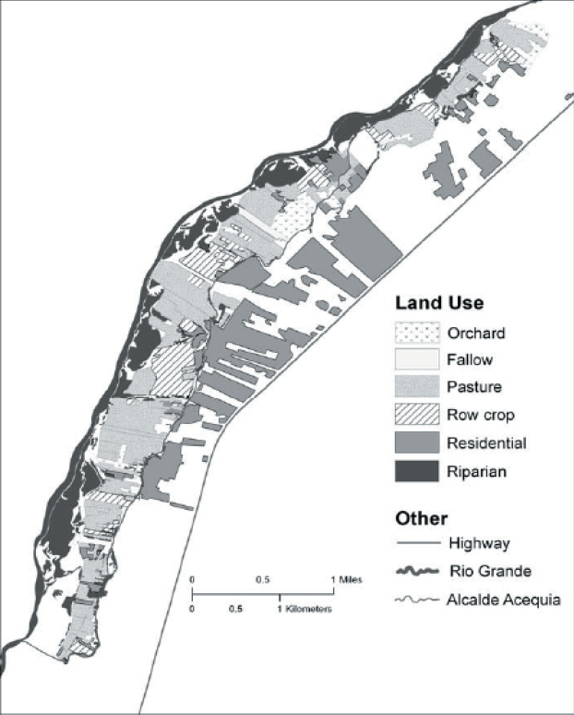
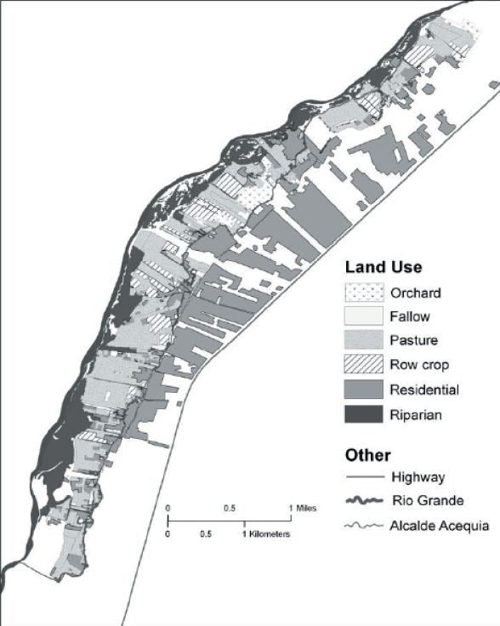
Land use change
1962
1997
2003
Pressure on farmed land
Residential development!!!!
Pressure on fallow land

Slide 10
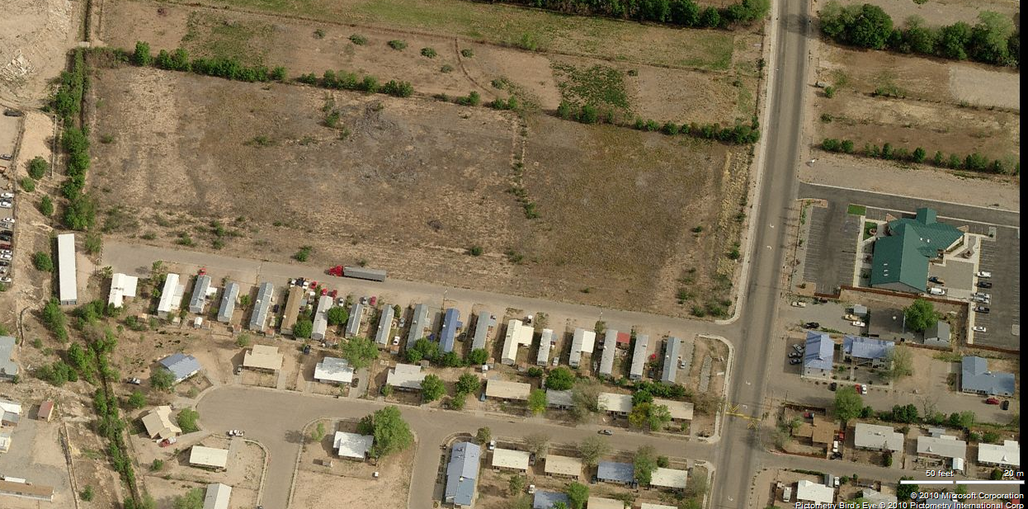
Value elicitation exercise
Acequia
What we did
Value elicitation with expert (J.P.)
- What are the (non-market and market) values associated with the acequia
- Who cares about these values (stakeholders)
- What are the threats to the values (and who cares)
- Can we see any patterns?

Slide 11
Stakeholders and threats
1
Internal friction exists within the acequias that can be attributed largely to the three stakeholder groups that have a connection to the acequia by virtue of their water right, water use, or both.
2
The cultural integrity of the acequias seems to be of interest primarily only to those directly involved in these common pool resource systems.
3
The second order effect of increasing subdivision, smaller parcel size, and non-traditional house owners moving into acequia regions, increases water use which affects most stakeholders.

Slide 12
Values and threats
Note: ✓ means that the values are directly affected by the threat. *means that the values are indirectly affected by the threat.
The pressure of increasing residential development, which is external to the acequia community and where the acequia members potentially have the least influence, affects all non-market and market values.
4

Slide 13
A four-scale complex resource management problem:
The case of the New Mexico Acequias
Global
Internal friction
Acequia
1
New Mexico state
Local community
Cultural integrity
2
Subdivision
3
Population increase
4
Water use increase
Climate change

Slide 14
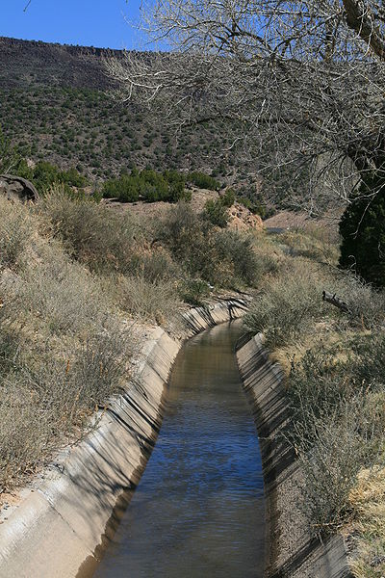
What we (or mostly J.P.) do next …..
1
Internal friction
Survey work to figure out how to best address (i.e. communication/prioritisation)
2
Cultural integrity
3
Subdivision
Simulation of ‘parcientes’ making choices about whether to participate in the acequia system and/or whether to sell part of their land. In an agent-based model, every agent would personally determine the set of actions that would bring it the most value, allowing for elements such as cultural heritage to factor into choices about land use.

Slide 15

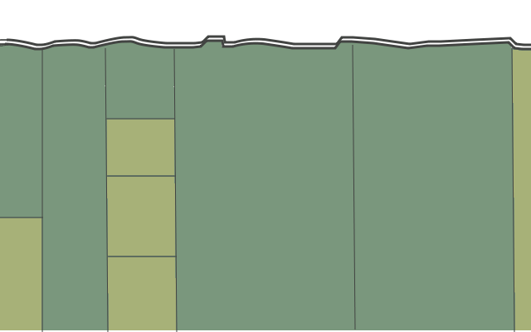
Proposed Model
Agent goal: maximize projected utility, where
Utility = ƒ( profit from selling land, profit from working land, cost of maintaining acequia, commitment to cultural history of using the acequia)
profit from selling land = ƒ(land size, land price)
cost to maintain acequia = ƒ( # acequia members)
profit from working land = ƒ(land size, acequia access)

Slide 16
What we (or mostly J.P.) do next …..
1
Internal friction
2
Cultural integrity
3
Subdivision
4
Population increase
A computational model based on Geographical Information System (GIS)-based census data on such as: watersheds, aquifers, population trends, land use, land value, and climate.
The GIS model can highlight the acequias that are most at risk in terms of subdivision and the socio-cultural impacts as a result of increased population growth, economic decline, or reduced water basin drainage areas, etc.
Combining 3 and 4 provides an understanding of the complex large scale physical interactions and the added complexity of ‘parciente’ decision making processes.

